Slide 1
Case Study:
CHORUS
</
} /> [
/>
Operating Systems
Reference:
Distributed Operating Systems Book by
Andrew S. Tanenbaum
Deck Created By:
Divya Hari Kumar
https://in.linkedin.com/in/divyaharikumar

Slide 2
</ Table of contents
{01}
{05}
Introduction to Chorus
Unix Emulation in Chorus
{02}
{06}
Process Management in Chorus
Cool: Object-Oriented Subsystem
{03}
{07}
Memory Management in Chorus
Comparison of Amoeba, Mach, & Chorus
{04}
{08}
Communication in Chorus
Summary
Implementation of Chorus

Slide 3
01
Introduction to Chorus
</>
} /> [

Slide 4
</ Introduction
modern, microkernel-based operating system
has evolved significantly over the years
documentation employs nonstandard terminology

Slide 5
</ History
} /> [
Origins:
Started as a research project at INRIA, France, in 1980.
Version 0 (1980-1982)
Version 1 (1982-1984)
Version 2 (1984-1986)
Version 3 (1987-present)
Architecture: Based on actors, macroscopic finite-state automata
Technicalities: Written in interpreted UCSD Pascal, running on 8086s connected by a ring network.
Focus: Multiprocessor research, using SM90 multiprocessors with Motorola 68020 CPUs.
Functionality: One UNIX CPU - I/O & file services.
Technicalities: Written in compiled Pascal, distributed to universities & companies.
Added features: Structured messages and fault tolerance.
Major rewrite: Rewritten in C
Compatibility: Designed to be compatible with UNIX at the source code level.
Kernel Redesign: Introduced a microkernel architecture, minimizing functionality.
Added features: Support for distributed applications, introduction of RPC.
Transition: Commercial product by Chorus Systèmes.
Technical changes: Remote Procedure Call (RPC) became the primary communication model.
UNIX Emulation: Enhanced UNIX emulation capabilities, including binary compatibility for existing UNIX programs
/>

Slide 6
</ Goals
} /> [
High-performance UNIX Emulation:
provide robust compatibility with UNIX systems
Use on Distributed Systems:
function effectively in distributed computing environments
seamless operation across multiple machines
Real-time Applications:
support applications that require real-time processing
Integrating Object-oriented Programming:
incorporating object-oriented programming principles into its architecture
enhancing flexibility and maintainability
/>

Slide 7
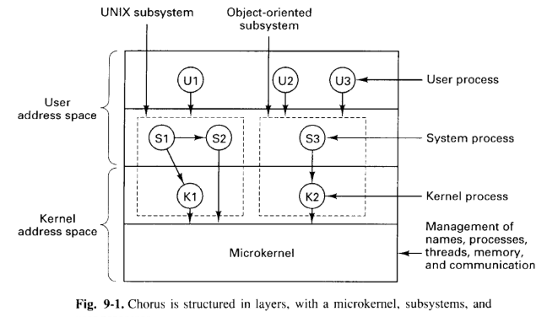
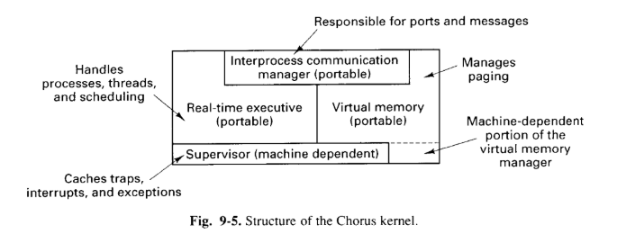
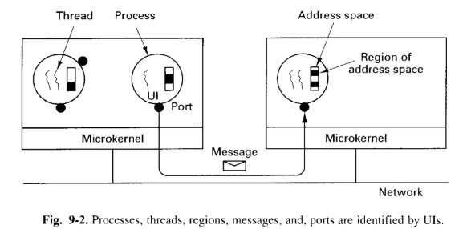
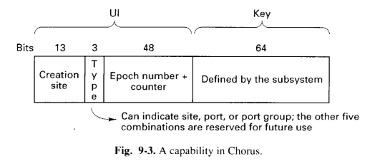
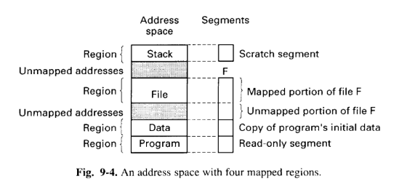
System Structure
Kernel Abstractions
Kernel Structure
Layered architecture designed for Distributed Systems.
Key Components:
Microkernel: managing names, processes, threads, memory, and communication.
Kernel Address Space: where kernel processes reside and execute.
Kernel Processes: dynamic entities that extend the microkernel functionality, loaded and unloaded during system execution.
Microkernel Architecture: Minimal core for essential services.
Layered Structure: Modular, extensible architecture.
Dynamic Loading/Unloading: Load/unload kernel processes.
Unique Identifiers (UIs): Unique IDs for resources.
Communication via Ports: Message-based comm.
Subsystems: Specialized services.
Segmentation: to manage memory.
Mapped Regions: contain multiple segments(representing a region of memory)
Data Sharing: shared between processes(data sharing and inter-process comm)
Dynamic Mapping: dynamically mapped and unmapped(flexible memory management)
Layered Architecture: Organized in layers, each with specific functions
Supervisor: Handles hardware, interrupts, context switching
VM Manager: Manages paging, caches
Mapper: Controls high-level paging, supports custom strategies
Real-Time Executive: Manages processes, threads, scheduling, synchronization
IPC Manager: Facilitates message passing

Slide 8
02
Process Management in Chorus
</>
} /> [

Slide 9
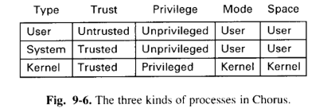
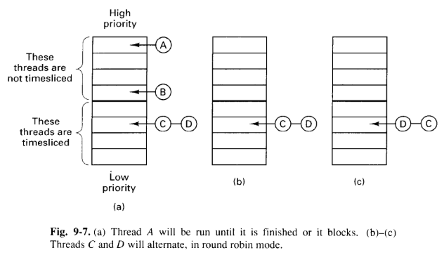
Processes
Composition:
combination of active (threads) and passive elements (address space, regions, ports).
Types:
Kernel Processes: Most powerful, run in kernel mode, and can be dynamically loaded/unloaded.
System Processes: Trusted, run in user mode, and can directly call the kernel.
User Processes: Untrusted, run in user mode, and can only make kernel calls through their assigned subsystem.
Scheduling
Priority-Based Scheduling
Absolute Priority: Absolute priority calculated as the sum of its process priority and its own relative priority.
Highest Priority First: Kernel executes the thread with the highest absolute priority.
Multiprocessor Support: Highest-priority threads are executed concurrently.
Real-Time Support: High-priority threads are not time-sliced and run until completion or voluntary release.

Slide 10
03
Memory Management in Chorus
</>
} /> [

Slide 11
Regions & Segments
Regions
Segments
A contiguous range of virtual addresses in a process's address space.
Page-aligned for efficient memory management.
All bytes within a region have the same (uniform) protection attributes (e.g., read-only, read-write).
Shared by all threads within the same process.
Two regions within a process cannot (no) overlap.
Contiguous collections of bytes named and protected by a capability.
Can represent files, swap areas on disk, or other data structures.
Accessed using system calls that provide the segment's capability, offset, and transfer direction.
Can be mapped onto regions, allowing for dynamic memory management.
A segment's size doesn't necessarily need to match the size of its mapped region. (segment size != region size)

Slide 12
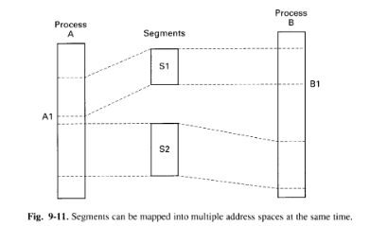
Mappers
Mappers:
"Mach-style" external pagers(mappers)
Segment Control:
Mapper (controls) -> (>=1) segments (mapped onto) -> regions
Multiple Mappings:
A segment can be mapped into multiple regions, even in different address spaces
Allows for shared memory and efficient data access
Page Caching:
The kernel maintains a page cache to store frequently accessed pages
Improves system performance
Reducing the need to fetch pages from disk repeatedly
Page Fault Handling:
When a page fault occurs, the kernel checks if the needed page is in the cache
If not, it requests from the corresponding mapper
Mapper Responsibilities:
Responsible for fetching pages from disk(if not in their own cache)
They then notify the kernel, updates the page tables, resumes the faulting thread

Slide 13
Distributed Shared Memory
Paged Distributed Shared Memory:
Chorus supports a style of distributed shared memory.
Similar to the IVY system.
Dynamic and Decentralized:
Management of shared memory is D&D.
Different managers keep track of different pages
Manager for a page can change as the page moves around the system.
Segment as Unit of Sharing:
The unit of sharing between multiple machines is the segment.
Fragmentation:
Segments are divided into fragments of one or more pages.
Access Control:
At any given moment, a fragment is either:
Read-only: It can be present on multiple machines.
Read-write: It is present on only one machine.
Benefits:
Data sharing
Flexibility
Scalability

Slide 14
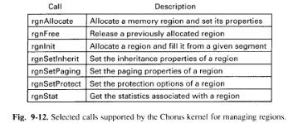
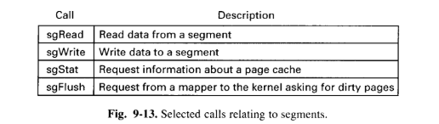
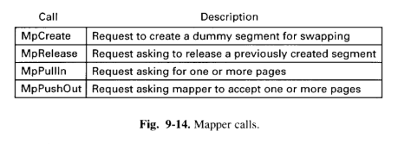
Kernel Calls
rgnAllocate: Create new region with specified properties.
rgnFree: Release allocated region.
rgnInit: Allocate & initialize region with segment data.
rgnSetInherit: Control property inheritance for child processes.
rgnSetPaging: Set paging properties for the region.
rgnSetProtect: Modify access permissions (read/write/execute).
rgnStat: Get region information (size, address, attributes).
MpCreate:
Create dummy segment, allocate disk space, return capability.
MpRelease:
Release dummy segment and free resources.
MpPullin:
Kernel requests data from segment, mapper responds.
MpPushOut:
Kernel transfers pages to mapper (caching, disk write).
sgRead & sgWrite:
Read/write data between segment and buffer.
sgStat:
Get segment statistics (size, usage).
sgFlush:
Send segment pages to mapper (for caching, distributed memory).

Slide 15
04
Communication in Chorus
</>
} /> [

Slide 16
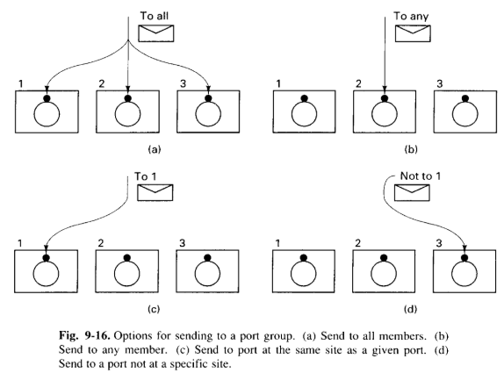
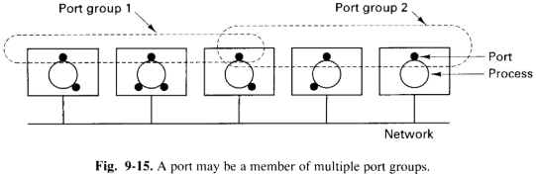
Communication
Ports
Comm. Operations
Ports can belong to multiple groups.
Enables flexible message routing.
Example: Service in "general" & "location-specific" groups.
Sending to Port Groups:
(a) All members: Send to every port in the group.
(b) Any member: Send to one arbitrary member.
(c) Same site: Send to a member on the same machine as a given port.
(d) Not at site: Send to a member not on a specific machine.

Slide 17
05
Unix Emulation in Chorus
</>
} /> [

Slide 18
Structure & Extensions
Structure of a UNIX Process
Extensions to UNIX
Distributed Programming:
Supports threads, RPCs for distributed computing.
Thread Support:
Enables concurrent execution within UNIX processes.
RPC Support:
Facilitates communication between processes on different machines.
Leverages Chorus Features:
UNIX processes can utilize Chorus features like message passing and resource management.
Chorus User Process:
Inherits Chorus features (access control, resource management).
Chorus Segments:
UNIX segments mapped to Chorus segments for memory management.
Subsystem Interaction:
UNIX processes interact with the kernel via the UNIX subsystem ("Mix").
Capability-Based Access:
UNIX concepts (files, directories, etc.) represented as Chorus capabilities for kernel interaction.

Slide 19
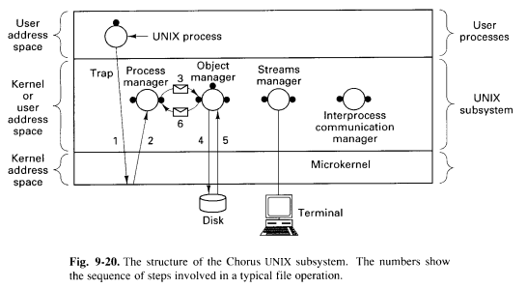
Implementation of UNIX on Chorus
Chorus is composed of four principal components:
Process Manager
Object Manager
Stream Manager
Interprocess Communication Manager
Key Points:
Modularity
Compatibility
Flexibility

Slide 20
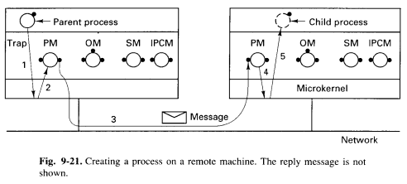
Process Manager
The Central Hub:
core component for all UNIX system calls
System Call Handler:
intercepts system calls, decides what to do, and coordinates with other managers
Process Lifecycle:
manages the entire lifecycle of UNIX processes
creation, termination, and signal handling
Resource Allocation:
handles resource allocation and deallocation
Inter-Manager Coordination:
acts as the central coordinator
interacting with the Object Manager, Streams Manager, and Interprocess Communication Manager as needed
Acts as a coordinator for the other three types of managers.

Slide 21
Managers
Object Manager
Stream Manager
Interprocess Communication Manager
Manages tangible information: files, swap space, etc.
Handles page faults and disk I/O.
Works with segments named by capabilities.
Manages file descriptors for UNIX processes.
Handles System V streams (devices, sockets, pipes).
Manages I/O operations for these devices.
Handles networking (TCP/IP).
Provides inter-process communication mechanisms.
Handles legacy System V IPC mechanisms (messages, semaphores, shared memory).
Less efficient and less desirable compared to modern Chorus IPC mechanisms.
Might be avoided in favor of using Chorus's own IPC mechanisms.

Slide 22
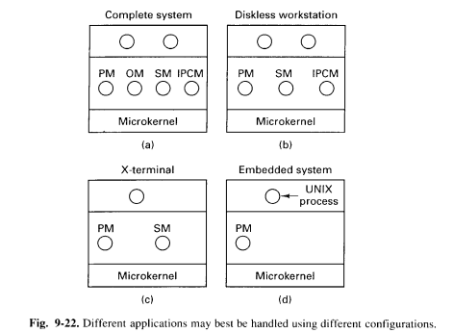
Configurability
The Chorus UNIX subsystem is highly configurable, allowing it to be adapted to various use cases and resource constraints.
Different Configurations for Different Needs:
Complete System: Includes all components (PM, OM, SM, IPCM) for full functionality.
Diskless Workstation: Omits OM, relies on external file server.
X-Terminal: Omits OM and IPCM if not needed (e.g., no local files or System V IPC).
Embedded System: Includes only PM for minimal resource usage.

Slide 23
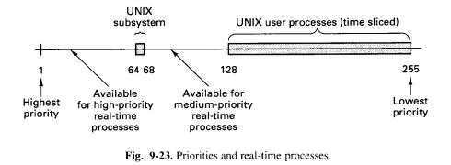
Real-time Applications
provides a suitable environment for real-time applications
priority-based scheduling
mechanisms for minimizing interrupt latency
flexible configuration options allow for the integration of real-time tasks alongside standard UNIX processes
possible to build systems that can handle both:
general-purpose computing
time-critical applications
within a single environment.
Priority-Based Scheduling
Minimizing Interrupt Latency
Flexibility

Slide 24
06
COOL: Object-Oriented Subsystem
</>
} /> [

Slide 25
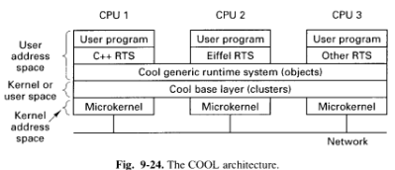
COOL Architecture
Layered Structure:
COOL Base Layer: Foundation, global address space
Generic Runtime System: Common services
Language Runtime Systems: Language-specific features
User Programs: Top layer
Global Address Space: Shared across machines, similar to a distributed file system.
Object-Oriented Paradigm: Supports object-oriented programming principles.

Slide 26
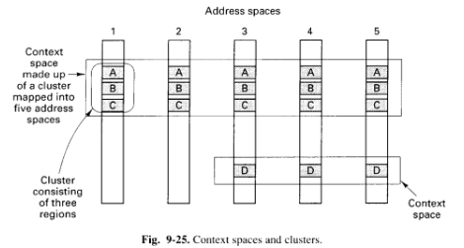
Base Layer & Runtime Systems
COOL Base Layer
COOL Generic Runtime System
Language Runtime System
Foundation: Core layer for the COOL system.
Global Address Space: Unifies access to objects across machines.
Cluster Abstraction: Groups related objects for efficient management.
Context Space: Manages address spaces for flexible object sharing.
Object Management: Manages object lifecycle (creation, deletion, mapping).
Cluster and Context Space: Uses these concepts for efficient object management.
Local/Remote Invocations: Optimizes by handling local invocations efficiently.
Performance Optimization: Minimizes overhead of remote invocations.
Language Runtime System Interaction: Coordinates with language-specific systems for object management.
Interface Definition Language: Defines objects for runtime invocation.
Remote Invocation Control: Controls local vs. remote execution of object methods.

Slide 27
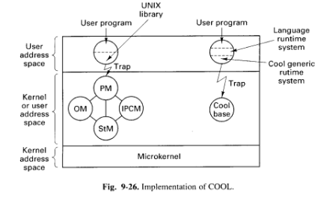
Implementation of COOL
Microkernel-Based:
Runs on top of the Chorus microkernel.
Components:
COOL base layer, generic runtime system, language library.
Modular Design:
Allows coexistence of COOL and UNIX processes.
Flexibility:
Enables the integration of different subsystems.

Slide 28
07
Comparison of Amoeba, Mach, & Chorus
</>
} /> [

Slide 29
</ Philosophical comparison
Feature | Amoeba | Mach | Chorus
User Model | Processor Pool | User-Centric | Evolved towards UNIX
Kernel Design | Minimalist | Larger Kernel | Intermediate
Focus | Distribution | User-Centricity | Modularity and Flexibility
Evolution | Designed as distributed | Evolved from single-processor | Evolved from distributed research
These three operating systems reflect different design philosophies.
Chorus strikes a balance between these two approaches, evolving towards a UNIX-like model while retaining its focus on distribution and flexibility.

Slide 30
</ Object Models comparison
Feature | Amoeba | Mach | Chorus
Core Concept | Objects | Objects | Objects
Object Definition | User-defined | Built-in | Built-in and Subsystem-defined
Object Location | Broadcast-based | Port-based | Capability-based
Capability Management | User-space | Kernel-space | Capability-based
Object Protection | Capabilities | Kernel-managed | Capabilities
Object Model Complexity | Rich, user-defined | Limited, built-in | Hybrid, combining built-in and user-defined
While all three systems utilize the concept of objects, they differ in the types of objects supported, how objects are managed and protected, and the role of objects in the overall system architecture.
Chorus strikes a balance between these approaches, providing a flexible framework for object-oriented programming.

Slide 31
</ Processes comparison
Feature | Amoeba | Mach | Chorus
Multithreading | Supported | Supported | Supported
Thread Scheduling | Kernel-managed | Kernel-managed | Kernel-managed
User Control over Threads | Minimal | More control (priorities, policies) | More control (priorities, policies)
Multiprocessor Support | Limited | Extensive | Limited
Process Placement | Dynamic load balancing | User-centric | Flexible placement
Synchronization Primitives | Mutexes, semaphores | Mutexes, condition variables | Mutexes, semaphores
While all three systems support multithreading, they differ in the level of user control over thread scheduling, multiprocessor support, and process placement.
Chorus strikes a balance between these approaches.

Slide 32
</ Memory Model comparison
Feature | Amoeba | Mach | Chorus
Memory Unit | Segment | Page | Segment with paging
Paging Support | No | Yes | Yes
Memory Sharing | Capability-based | Capability-based | Distributed shared memory
Memory Management Complexity | Simpler | More complex | Intermediate
Focus | Simplicity and performance | Flexibility and efficiency | Balance of both
Chorus combines elements of both, leveraging segments and demand paging for flexible and efficient memory management in a distributed environment.

Slide 33
</ Communication comparison
Feature | Amoeba | Mach | Chorus
Communication Paradigm | RPC-based | Port-based | Port-based
Communication Layer | User-level | Kernel-level | Kernel-level
Broadcast Support | Yes, built-in | No | Limited
Interface Complexity | Simple | Complex | Simpler than Mach
Network Communication | FLIP protocol | Network message server | Kernel-level
Chorus strikes a balance between these two approaches, providing a simpler communication model than Mach while still supporting basic features like port-based communication and limited broadcasting.

Slide 34
</ Servers comparison
Feature | Amoeba | Mach | Chorus
Server Model | Specialized Servers | Single BSD Server | Multiple Processes
Access Control | Capabilities | UNIX Permissions | Capabilities
UNIX Emulation | Source-Level | Binary Compatibility | Hybrid (Source and Binary)
Distributed Computing Focus | High | Limited | High
Object Replication | Supported | Limited | Supported
Chorus combines elements of both approaches, using a collection of processes with some containing actual UNIX code.

Slide 35
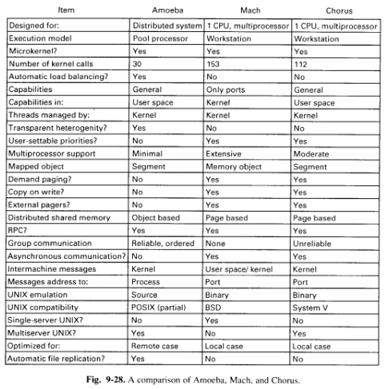
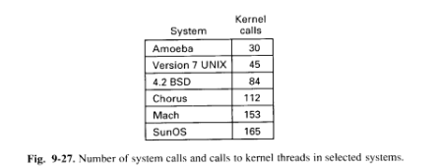
Comparison Charts

Slide 36
08
Summary
</>
} /> [

Slide 37
</ Summary
Key Features
Components and Concepts
Microkernel-based
Distributed systems support
UNIX compatibility
Real-time capabilities
Object-oriented programming support
Processes and Threads: Units of execution.
Regions and Segments: Memory management units.
Capabilities: Access control mechanism.
Ports and Port Groups: Communication channels.
Microkernel: Core system component.
Subsystems: Modules for specific functionalities (e.g., UNIX, COOL).
Chorus is a versatile operating system that combines the benefits of microkernel architecture with support for distributed systems, real-time applications, and object-oriented programming. Its modular design and flexible communication mechanisms make it well-suited for a variety of applications.
/> **
} /> [

Slide 38
</ Implementation of Chorus:
Exploring Possibilities
Security & Privacy | Performance & Scalability | Object-Oriented Programming | Real-Time Capabilities
Capability-Based Security: Fine-grained access control. Cryptography and Encryption: Secure communication and data storage. Trusted Execution Environments: Hardware-based security. | Hardware Acceleration: Optimize performance-critical tasks. Asynchronous I/O: Maximize resource utilization. Distributed Resource Management: Efficient resource allocation and load balancing. | Language Integration: Seamless integration with modern languages. Distributed Object Systems: Support for large-scale distributed applications. Fault Tolerance and Recovery: Ensure system reliability and data integrity. | Predictable Scheduling: Guaranteeing performance for real-time tasks. Resource Prioritization: Allocating resources to critical tasks. Time-Sensitive Networking: Deterministic network communication.
</>

Slide 39
</ Implementation of Chorus:
Addressing Limitations
Complexity: complexity of the Chorus architecture
Potential solutions:
Modular design
Clear documentation
Performance Overhead: overhead of the microkernel and the object-oriented approach
Potential Solutions:
Careful optimization
Use of hardware acceleration
Security Challenges: more complex and interconnected, security risks increases
Potential Solutions:
Strong security measures, including:
encryption
access control
regular security audits
</>

Slide 40
THANK YOU!
</
/>
} /> [
9
Case Study 3: Chorus

